Slide 1
CSCE 623 In Class Day 16
Synchronous session

Slide 2
Agenda
Key points for Unsupervised Learning
PCA & Clustering exploration
Break
Questions & Project Discussion

Slide 3
Key Points for Unsupervised Learning
What can you achieve with unsupervised learning?
What kinds of unsupervised learning techniques are there?
Highlighted Topics
PCA as dimensionality reduction
Clustering for Semisupervised Learning

Slide 4
What can you achieve with unsupervised (and semi-supervised) learning
Data visualization (display high-dim data in 3 dimensions or less)
Data segmentation/partitioning (e.g. market analysis)
Feature reduction as a preprocessing step (e.g. PCA)
Generating more labeled data
Pseudo-labeling / Semisupervised learning on existing observations
Generating new observations of data
Active Learning: Human-machine-team

Slide 5
What are some techniques for UL?
Dimensionality Reduction
PCA
Clustering
K-Means; Agglomerative; DBSCAN
Density Estimation (HOML)
Gaussian Mixture Models (GMM)
Anomaly Detection (HOML)
Gaussian Mixture Models

Slide 6
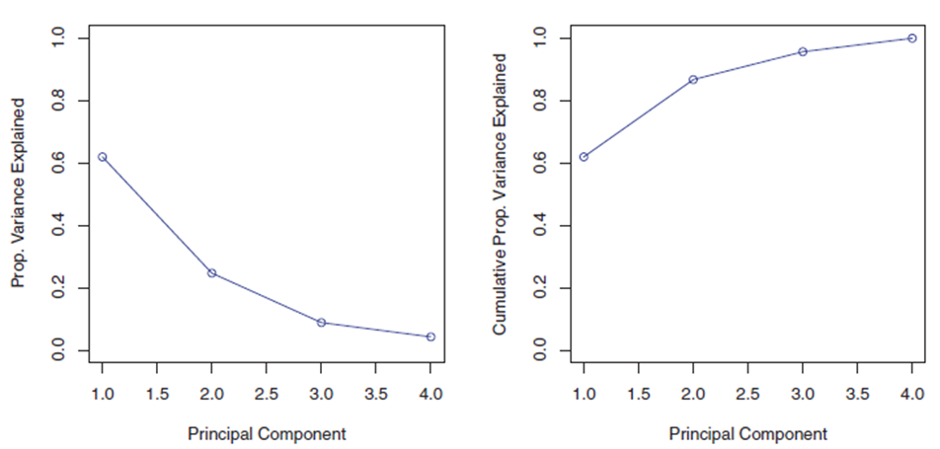
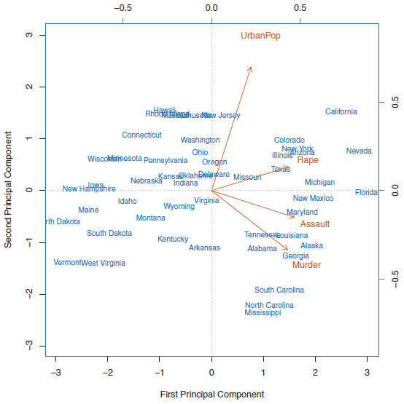
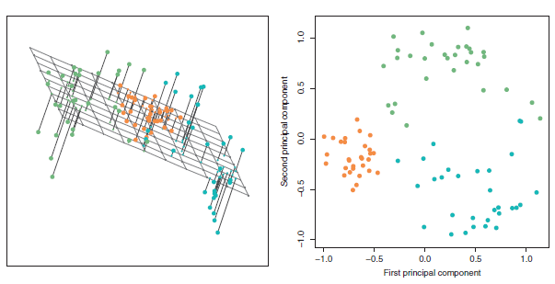
PCA
Linear transformation of the data into a new basis
Essentially rotates the axes of the original basis such that the first axis is the one with the highest variance through the data and subsequent axes are orthogonal to the first and selected in order of their remaining variance in the data
New feature count = old feature count unless choosing to use fewer axes
Can be used for visualization or dimensionality reduction
Things to consider
Doesn’t use labels
May not work well if data is in manifolds
If using for ML pipeline, respect the golden rule

Slide 7
PCA Playground
https://mlplaygrounds.com/machine/learning/PCA.html

Slide 8
K-means clustering
One of the simplest clustering techniques
Method:
Pick a quantity of clusters (K)
Assign locations for K cluster centers then Repeat until converge
Associate observations with their closest centers
Redetermine the centers (centroids)
Easy to understand/implement/interpret
Can be used for semi-supervised learning / pseudo labeling
Need to select cluster count (k) a-priori
Sensitive to feature scaling for certain distance measures (Euclidean)
Computationally expensive because distances must be computed from each point to each center

Slide 9
DBSCAN (density based scanning – clustering)
Creates clusters based on density of local region
Closeness of nearby points – interpoint distances
Hyperparameter epsilon – defines maximum distance to be a member
Hyperparameter minPts – defines minimum points required to be called a cluster
Number of clusters determined by the algorithm
Can create arbitrary shaped (e.g. nonlinear) clusters
Handles noise / allows outliers outside of clusters
Only 2 hyperparameters
Computationally complex O(n²)
Affected by curse of dimensionality

Slide 10
K-means & DBSCAN clustering playgrounds
https://cartography-playground.gitlab.io/playgrounds/clustering-comparison/ (K-means; DBSCAN)
https://www.naftaliharris.com/blog/visualizing-k-means-clustering/
https://www.naftaliharris.com/blog/visualizing-dbscan-clustering/

Slide 11
t-SNE (t-distributed stochastic neighbor embedding)
Visualization technique
Purpose:
Given a set of points in high-d space
Find a representation of those points in lower-d space (2D plane)
Method: Nonlinear transformations differ on different regions
Tunable parameter “Perplexity”
Balances attention between global and local aspects of neighbor closeness
Stochastic: May need to run multiple times w/ different settings

Slide 12
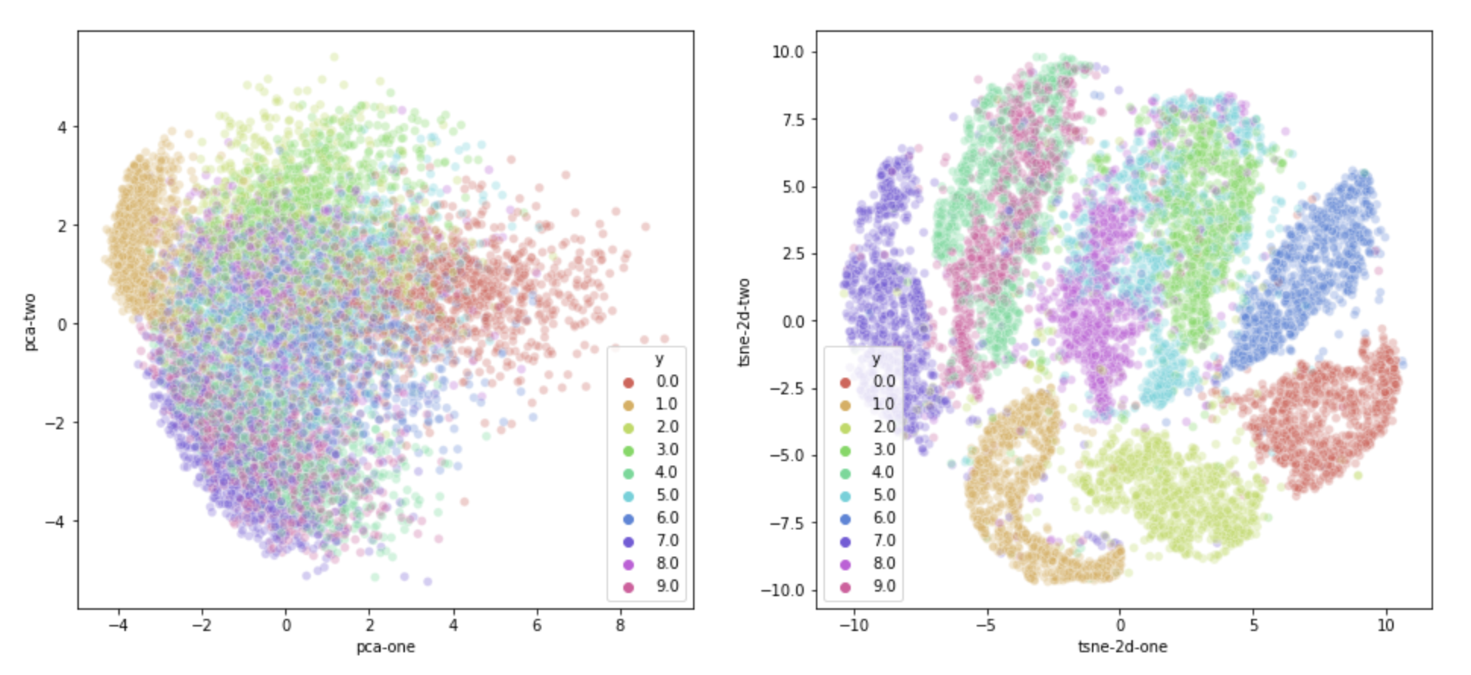
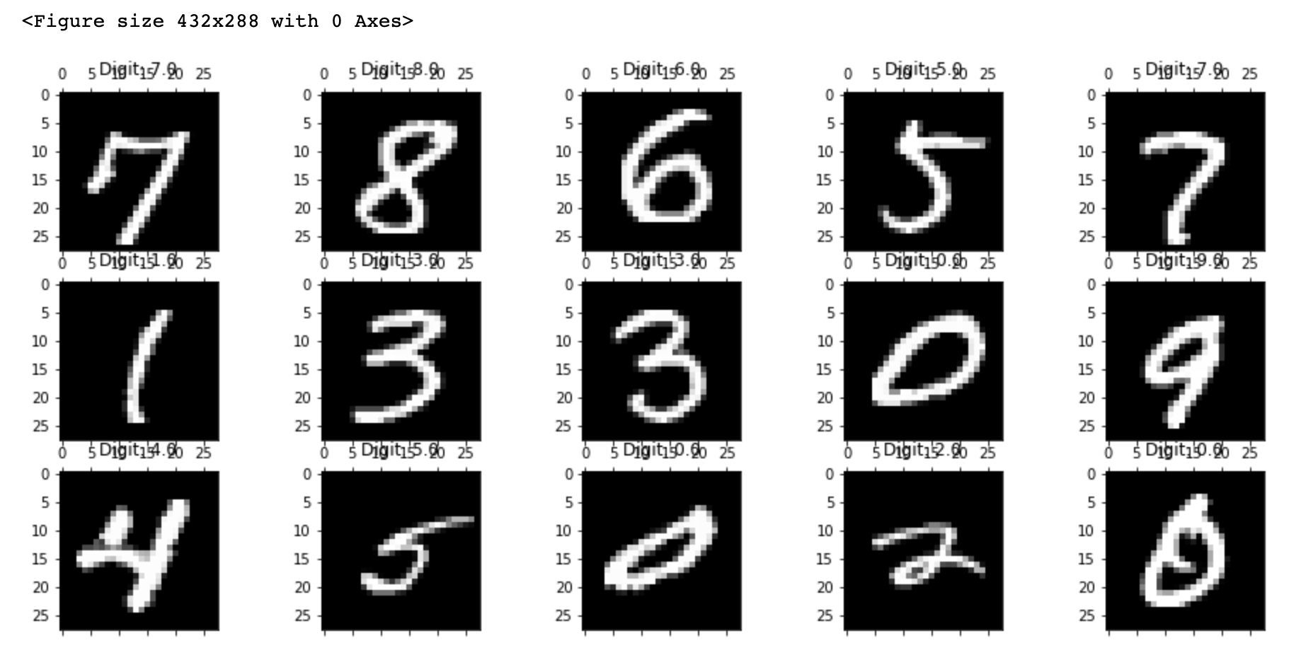
t-SNE things to be aware of
Things to consider
Stochastic!
Could be used for visual clustering, but interpretation of the visualization should be loose – inter-point and inter-cluster distances are not indicative of distances in feature space
Designed for data visualization… not as a preprocessing step: the output is the visualization
One way function… No way to invert a point back to original feature space
https://towardsdatascience.com/visualising-high-dimensional-datasets-using-pca-and-t-sne-in-python-8ef87e7915b

Slide 13
t-SNE playground
https://distill.pub/2016/misread-tsne/

Slide 14
Unsupervised Learning Coding Activity
Obtain the code from Canvas
Instructor Overview / Description of Task
Breakout Groups to work on coding (20 min)
Share your results

Slide 15
Break

Slide 16
Questions & Open Project Discussion

